Slide 1
Weakly Supervised Extraction of Cyber Attacks from Twitter with Turkish Tweet Analysis

Slide 2

Outline
What is an Information Security Analyst?
What does an Information Security Analyst do?
What is Natural Language Processing?
Why do we need Natural Language Processing?
Sample Tweets Related with a Security Incident
Why is NLP Hard?
Twitter Api
Contributions

Slide 3
What is an Information Security Analyst?
An information security analyst is someone who takes measures to protect a company's sensitive and mission-critical data, staying one step ahead of cyber attackers. They do this by coming up with innovative solutions to prevent critical information from being stolen, damaged or compromised by hackers.
Note the differences between a Security Analyst and a Security Administrator:
Security Analysts - are responsible for analyzing data and recommending changes to higher ups, but do not authorize and implement changes. Their main job is keeping attackers out.
Security Administrators - ensure that systems are working as designed by making changes, applying patches and setting up new admin users. Their main job is keeping systems up.
Key Notes

Slide 4
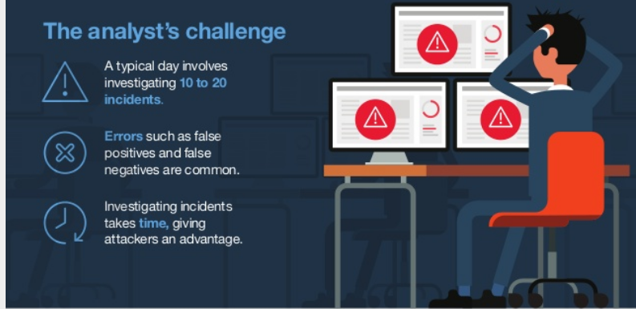
What does an Information Security Analyst do?
Key Notes

Slide 5
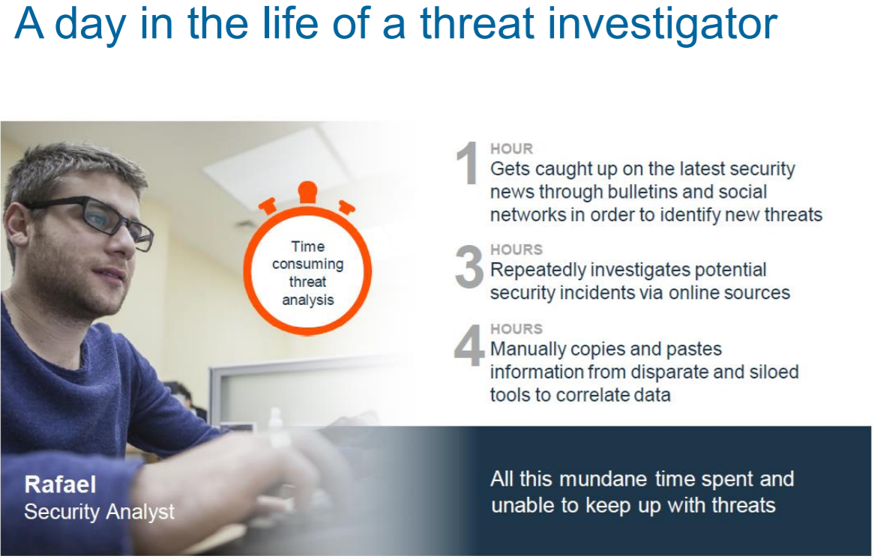
What does an Information Security Analyst do?
Key Notes

Slide 6
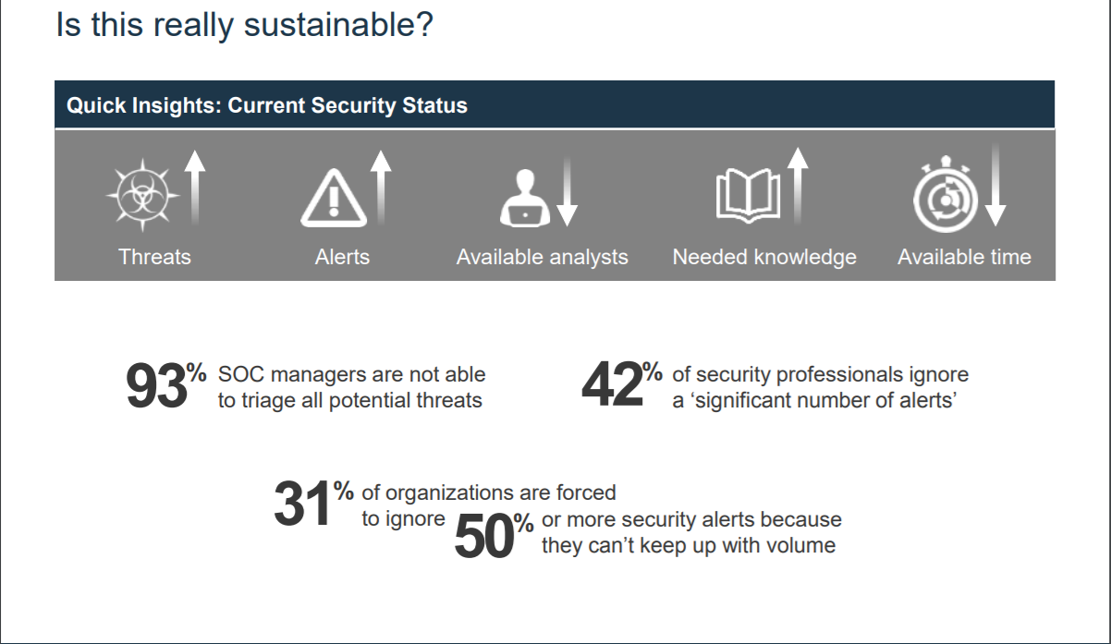
Key Notes

Slide 7
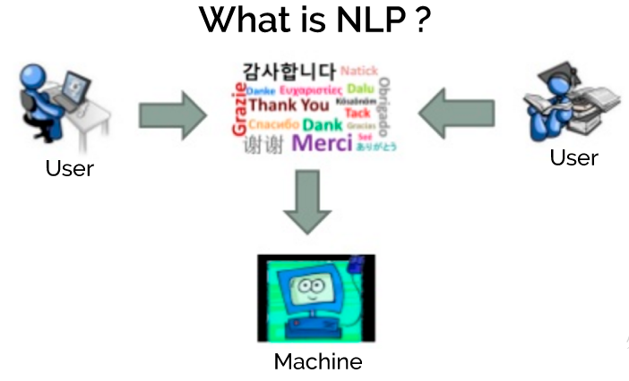
What is Natural Language Processing?
Key Notes
Natural Language Processing (NLP) is “ability of machines to understand and interpret human language the way it is written or spoken”.

Slide 8
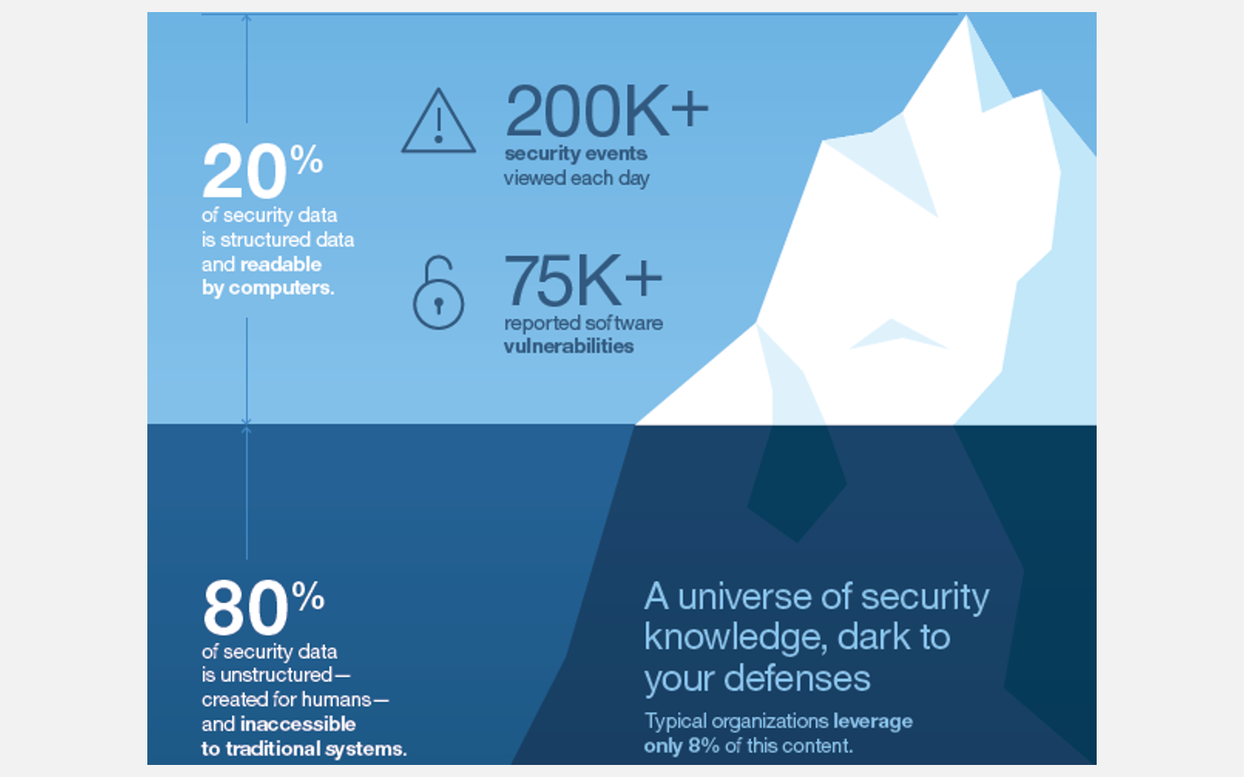
Why do we need Natural Language Processing?
Key Notes

Slide 9
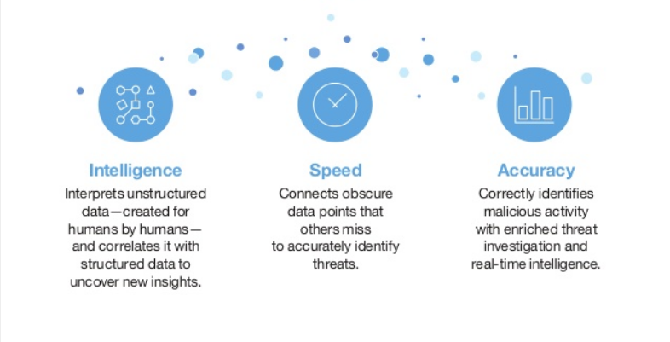
Why do we need Natural Language Processing?
Key Notes

Slide 10
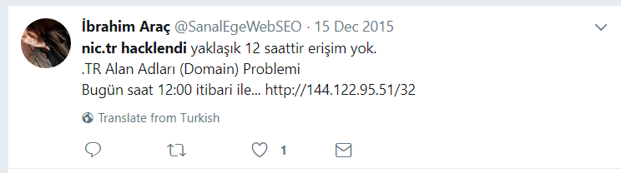
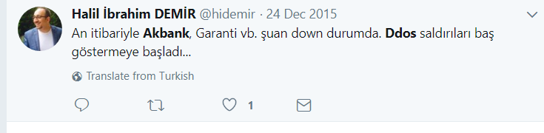
Sample Tweets After an Attack

Slide 11
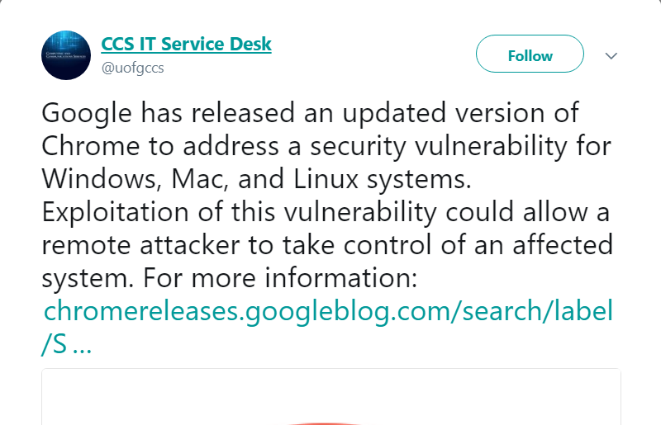
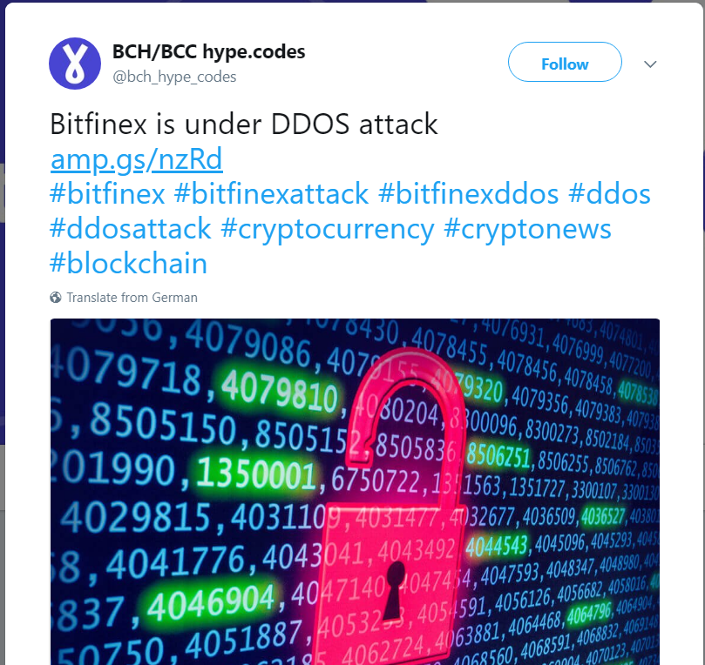
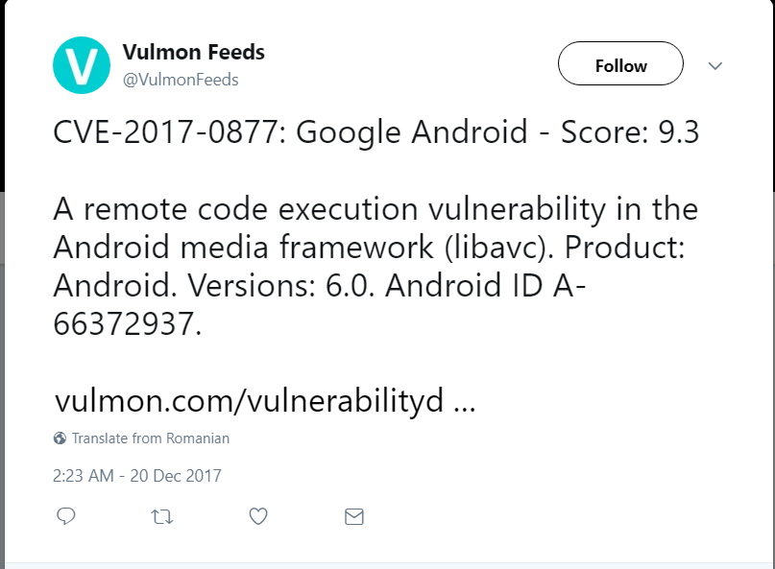
Sample Tweets

Slide 12
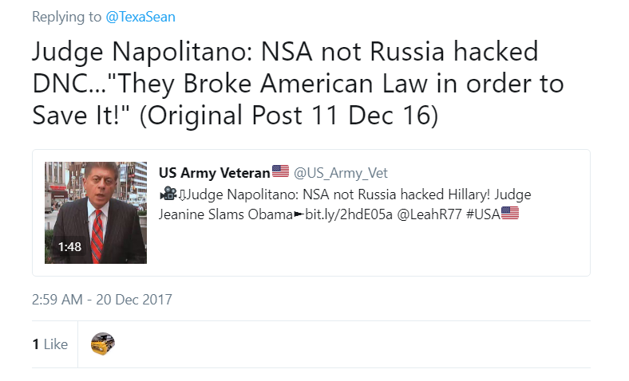
Sample False Positive

Slide 13
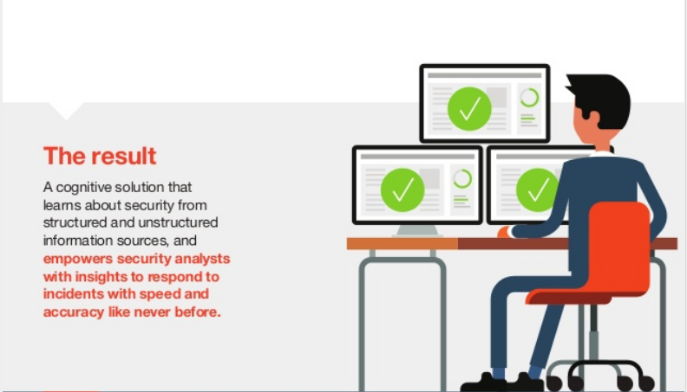
Cognitive Solution
Key Notes

Slide 14
Why is NLP Hard?
Language is highly ambiguous– it relies on subtle cues and contexts to convey meaning.
Take this simple example: “I love flying planes.”
Do I enjoy participating in the act of piloting an aircraft? Or am I expressing an appreciation for man-made vehicles engaged in movement through the air on wings?
A single sentence can carry different meanings. After thousands of years of evolution, languages have evolved to become shorter and less explicit. For humans, this is very efficient.
Key Notes

Slide 15
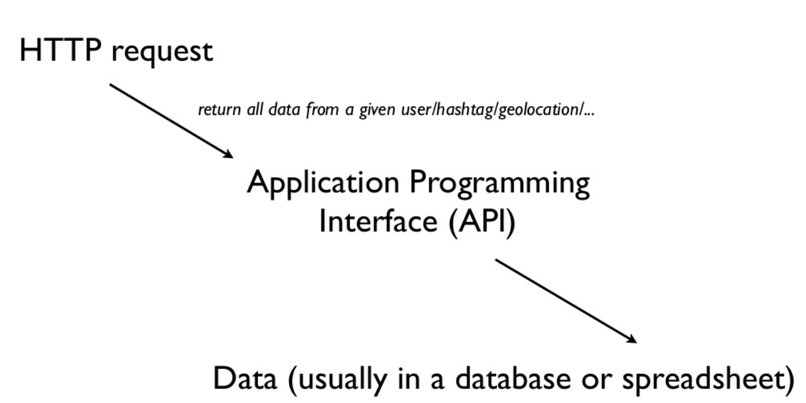
Extracting Twitter Data

Slide 16
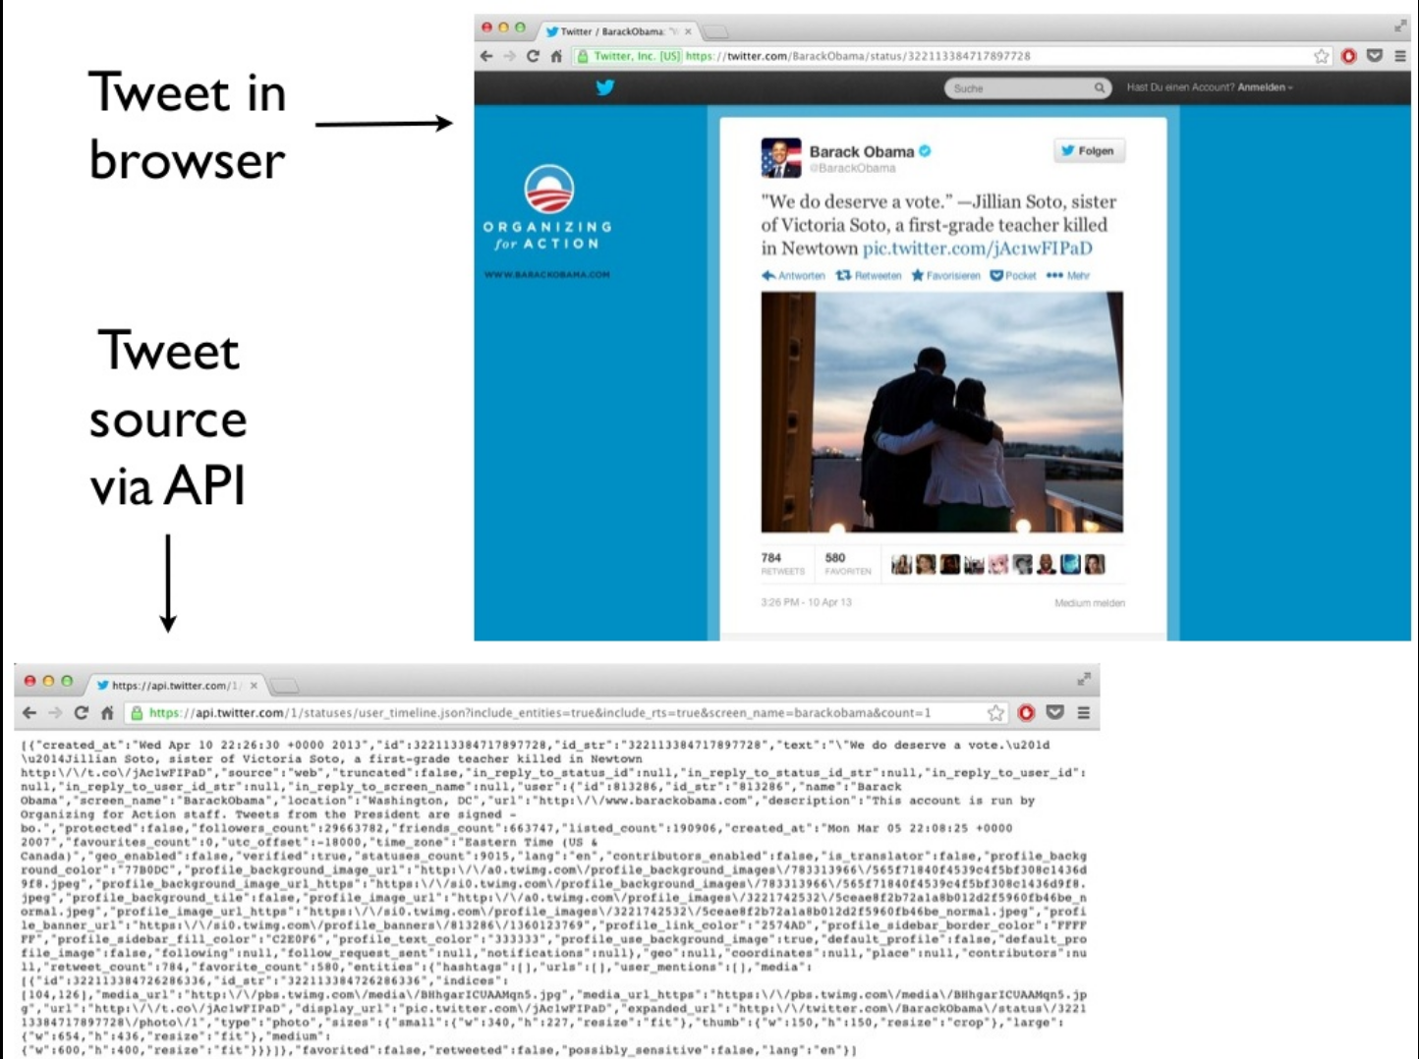
Extracting Twitter Data

Slide 17
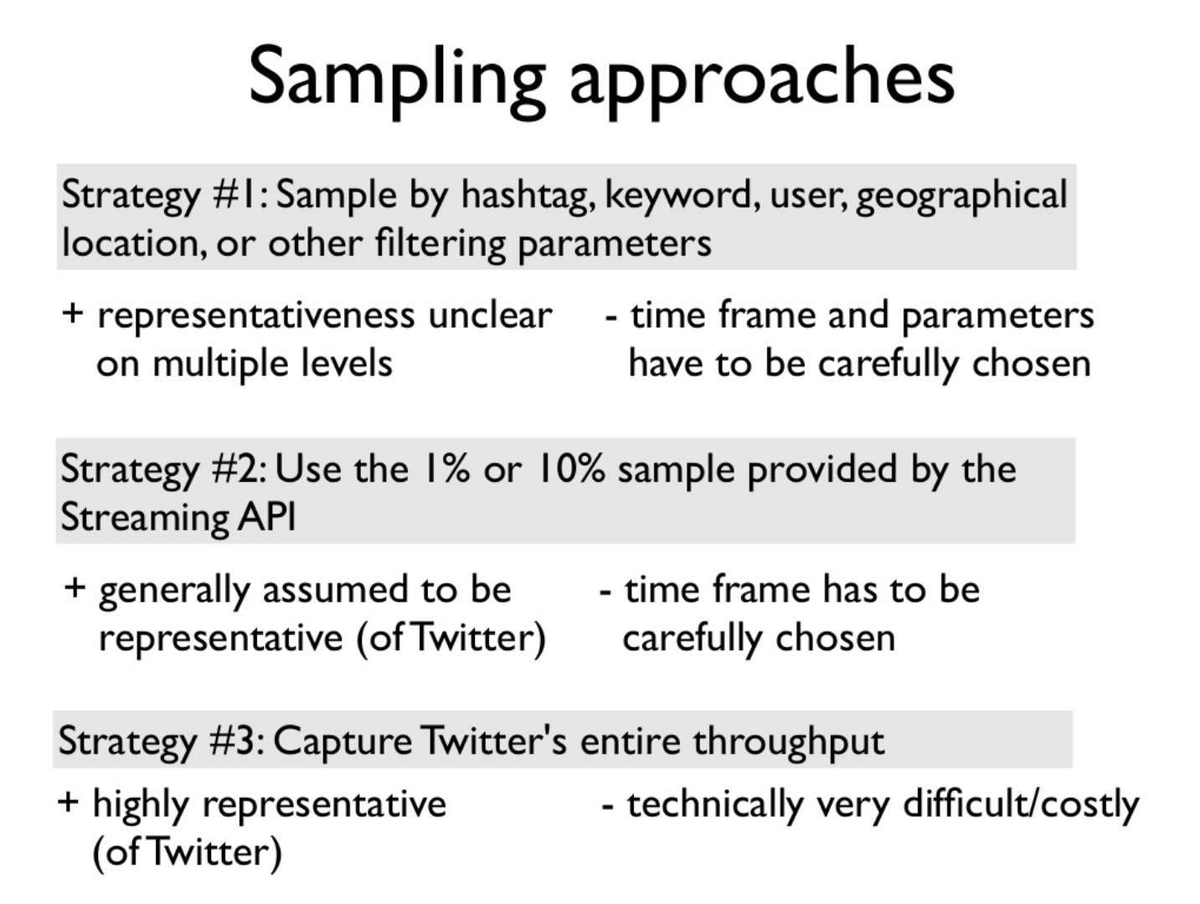
Extracting Twitter Data

Slide 18
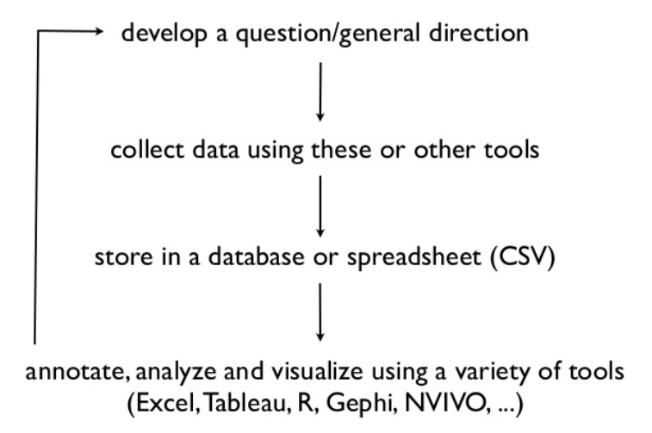
Extracting Twitter Data

Slide 19
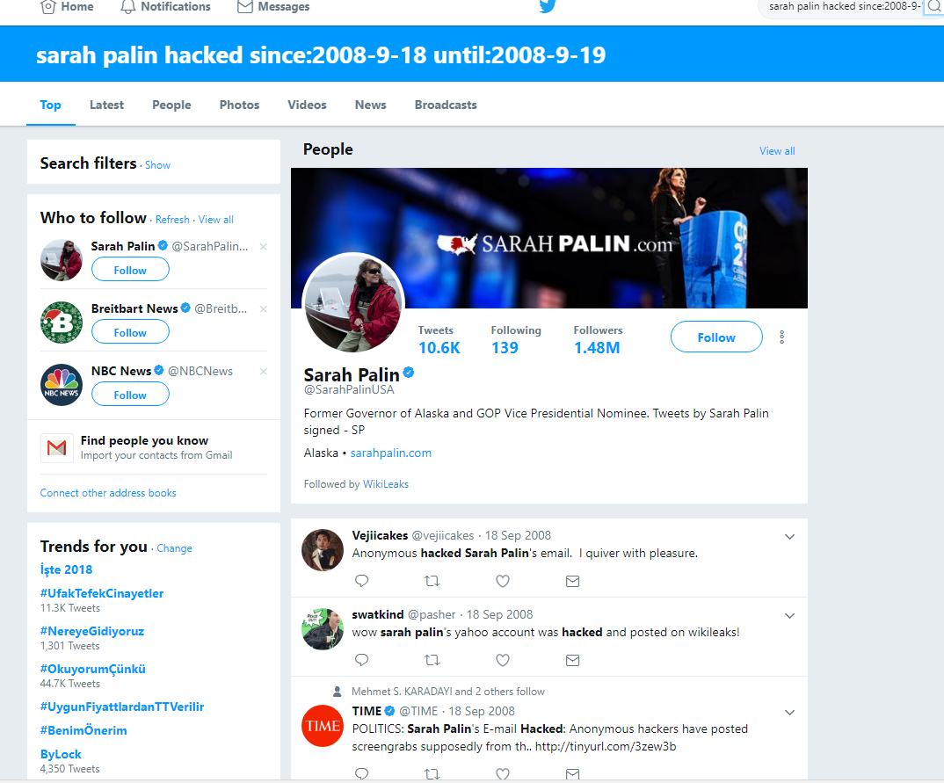

Slide 20
Related Work
There has been substantial amount of work on weakly supervised relation extraction.
Most previous work has focused on extracting static relations which remain relatively constant over time, for instance book authors, class/instance pairs, named entities or hypernyms.
Previous work on relation extraction has also addressed the challenge of false-negatives in weakly supervised learning.
Weekly Supervised Relation Extraction

Slide 21
Related Work
There has been much less work in contrast on weakly supervised event extraction
There are hundreds of thousands of sentences on the web which mention William Shakespeare as the author of Comedy of Errors, or that Nirvana plays grunge music, however there are typically only one or a handful of news articles that report on a specific event, such as a DoS attack.
Social media, however greatly lowers the barrier to publishing making it easy for anyone to comment on events as they take place. This leads to substantial redundancy of information, as many users will typically comment on events of interest.
This redundancy on Twitter makes seed-based weakly supervised event extraction a feasible task because it is easy to find a large number of event mentions for an event category given a few seed instances.
Weekly Supervised Relation Extraction

Slide 22
Related Work
There has been growing interest in information extraction and event identification in Social Media
In contrast to previous work on event identification in social media, we take a weakly supervised approach to extracting focused event categories where only a few seed instances are provided. We also are the first to demonstrate the prevalence of security-related events reported on Twitter, and investigate how to automatically detect them.
A small amount of recent work has explored extracting security related information from text, such as understanding software vulnerability ontologies.
Event Extraction

Slide 23
Contributions
• Demonstrate that social media is a valuable resource for information on security related events.
• Present a novel approach to extracting focused events from Twitter which requires only minimal supervision for each new event category.
• Turkish Tweet Analysis
Key Notes

Slide 24

What is an Information Security Analyst?
What does an Information Security Analyst do?
What is Natural Language Processing?
Why do we need Natural Language Processing?
Sample Tweets Related with a Security Incident.
Why is NLP Hard?
Twitter Api
Contributions
Thank you!
Questions
and
Answers

Slide 25

References
R. Heatherly, M. Kantarcioglu, and B. Thuraisingham. Preventing private information inference attacks on social networks. Knowledge and Data Engineering, IEEE Transactions on, 25(8):1849–1862, 2013.
https://www.ibm.com/security/cognitive
https://securityintelligence.com/events/cybersecurity-cognitive-era-priming-digital-immune-system/
http://www.ling.helsinki.fi/kit/2008s/clt231/nltk-0.9.5/doc/en/book.html
https://adeshpande3.github.io/adeshpande3.github.io/Deep-Learning-Research-Review-Week-3-Natural-Language-Processing

